Slide 1
A Study Of
The Book Of Revelation
August 8, 2021

Slide 2
Jewish Wedding …
Revelation 19
Consisted of three parts:
Betrothal – the time that the husband paid the dowry (Christ did for His bride too – Acts 20:28; 2 Corinthians 11:2)
  One who was espoused (betrothed) was considered to be the bride of the groom even before the marriage supper (Deuteronomy 22:23-24)
  “Among the Jews, the betrothal was so far regarded as binding that if marriage should not take place owing to the absconding of the bridegroom or the breach of contract on his part, the young woman could not be married to another man until she was liberated by a due process and a paper of divorce” (ISBE III: 1997).
Interval – where the partners live separately with their companions (Christ now in heaven waiting for his bride) – (Hebrews 10:12-13) same as already married. Joseph/Mary (Matthew 1:18-25; Luke 1:26-27; 2:5-6)
Wedding Supper – final vows of marriage (Ephesians 5:23ff;
1 Corinthians 15:24ff; cf. Matthew 22; 25 – lasted week or more)

Slide 3
Marriage of the Lamb
Revelation 19
“Wife made herself ready” Preparation!
“She would be clothed in fine linen”
Revelation 19:8, “… for the fine linen is the righteous acts of the saints.”
“Clean and bright”
The clothing of the bride of Christ is set in stark contrast to that of the harlot in Revelation 17:4 (seductive and luxurious clothing).
The bride symbolizes purity. Ephesians 5:27
Lord warns us to keep our garments spotless (16:15 – Matthew 22:1-13; 25:1-13)

Slide 4
Invitation List
Revelation 19
“Blessed” are those who have been called to the marriage feast
“True words of God” solemn emphasis concerning the good as well as the bad
Lord’s people invited to this supper
(Revelation 3:20)
Give divine assurance even to those who have faced severe persecutions this right to be theirs!

Slide 5
John’s Response
Revelation 19
John prostrated himself to worship the speaker – angel. (cf. Matthew 4:10)
  John did this once again at Revelation 22:8ff.
John is in awe and overwhelmed at the scene
Worshipping of angels foreign to the Lord’s church (Colossians 2:18)
Angel warns – DO NOT DO THAT!
(cf. Acts 14)
“Worship God” only!
Angels are fellow servants!

Slide 6
John’s Response
Revelation 19
NOTE: If Jesus were created like the angels, as Jehovah’s Witnesses teach, then He could not be worshiped (5:8-14).
Jesus was not created, nor has He ever been an angel (Hebrews 1:5-8).
Jesus was worthy to be worshiped even while on earth (John 9:35-38), because He IS God (John 1:1ff, 14).

Slide 7
John’s Response
Revelation 19
“Testimony of Jesus is the spirit of prophecy.”
All the word of God bears witness to Jesus and not to angels (1 Corinthians 12:3)
Jesus came to fulfill the Law and Prophets (Matthew 5:17; Luke 24:44-45; John 5:39)
Worship God the true author of all revelation – not the messenger!

Slide 8
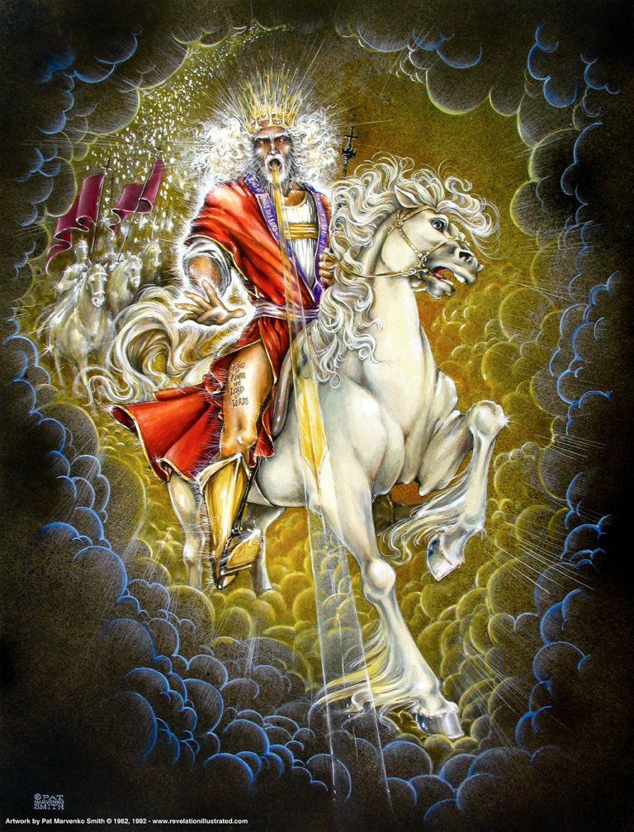
Christ The Victorious Rider Upon A White Horse (Revelation 19:11ff)

Slide 9

Revelation 19:11
Revelation 19
“And I saw the heaven opened; and behold, a white horse, and he that sat thereon called Faithful and True; and in righteousness he doth judge and make war.”

Slide 10
Revelation 19:12
Revelation 19
“And his eyes (are) a flame of fire, and upon his head (are) many diadems; and he hath a name written which no one knoweth but he himself.”

Slide 11
Revelation 19:13
Revelation 19
“And he (is) arrayed in a garment sprinkled with blood: and his name is called The Word of God.”

Slide 12
Rider on White Horse
Revelation 19
Victorious Christ
Leader on a white (Victory) horse
  Horse – the symbol of war or battle (Job 39:19-25;
  Zechariah 10:3) speed (Jeremiah 4:13) and victory Revelation 6:2
Identified – Faithful and True (Revelation 1:5 and 3:14). This is the Christ!
In righteousness, He judges and makes war
He is the leader of a spiritual army
Eyes like a flame of fire (1:14). This is the Christ!
Wearing many diadems – crowns of royalty –widespread dominion. See: 6:2
  Third time we see “diadems.” cf. 12:3; 13:1; and 19:12

Slide 13
Rider on White Horse
Revelation 19
Name which no one knows. Only God knows the full significance of the Savior’s name. (2:17)
  One’s name indicates all that he is!
  All I know is what is revealed.
Clothed with robe sprinkled in blood.
(Isaiah 63:1-6)
  Blood He shed on cross, or the blood from the winepress of His wrath. cf. Joel 3; Revelation 16
He comes to conquer.
Rules with a rod of iron. (cf. Psalms 2:9-12 and Isaiah 11:4).

